Slide 1
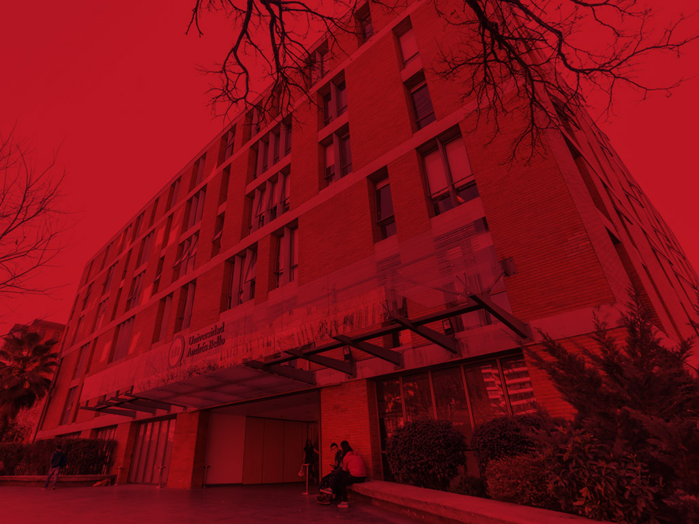


Tópicos de Especialidad Ciencia de Datos
Pablo Schwarzenberg
Facultad de Ingeniería
Integrantes:
José Musante
Rodrigo Menares
Jeremy Diaz
2024

Slide 2
Revisión Bibliográfica
Estimando el consumo de energía por medio de machine learning
https://www.sciencedirect.com/science/article/pii/S0743731518308773
Consumo y energía
https://www.sciencedirect.com/science/article/abs/pii/S0959652615006617

Slide 3
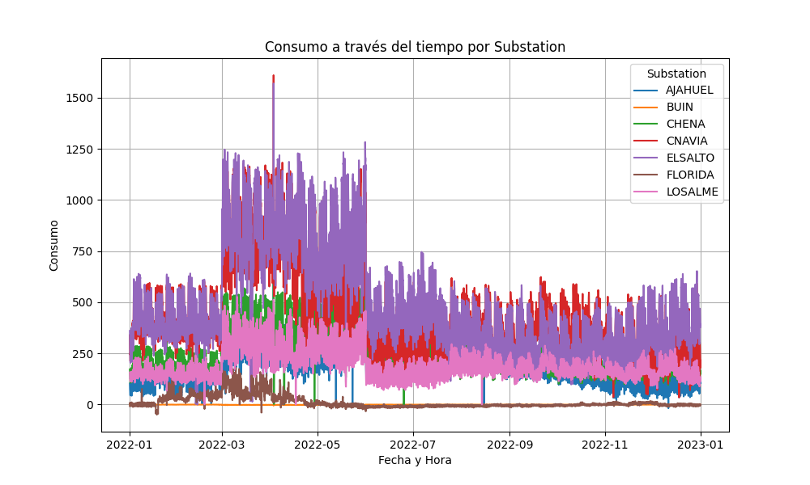
Análisis de datos

Slide 4
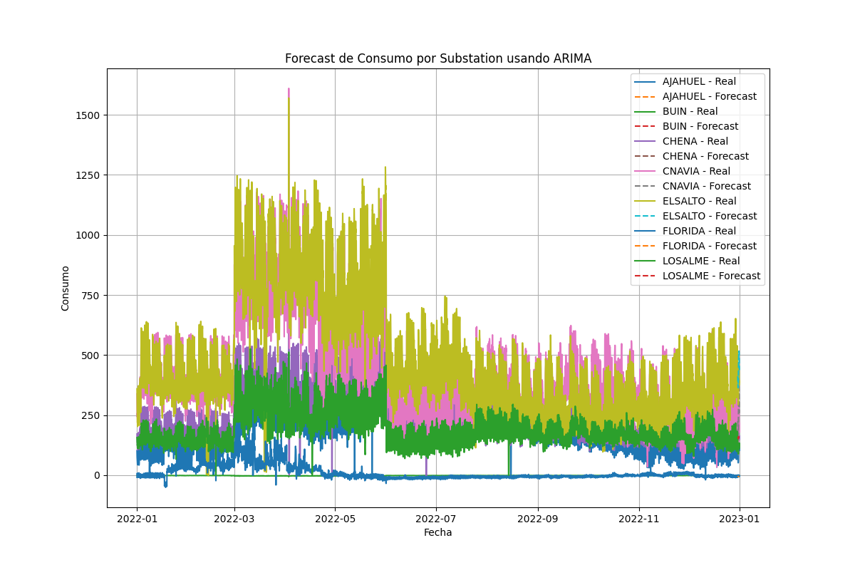
Análisis de datos por ARIMA

Slide 5
Experimentos
n
Substation | MAE | MSE | Accuracy | Precision | Recall | F1-Score
AJAHUEL | 43.527.341 | 2.663.715.236 | 1.000.000 | 0.000000 | 0.0 | 0.000000
BUIN | 0.173615 | 0.034809 | 0.791667 | 0.791667 | 1.0 | 0.883721
CHENA | 38.642.855 | 2.159.153.999 | 1.000.000 | 0.000000 | 0.0 | 0.000000
CNAVIA | 70.745.782 | 6.254.177.323 | 1.000.000 | 0.000000 | 0.0 | 0.000000
ELSALTO | 59.016.894 | 3.919.806.216 | 0.833333 | 0.000000 | 0.0 | 0.000000
FLORIDA | 2.743.764 | 12.406.244 | 1.000.000 | 0.000000 | 0.0 | 0.000000
LOSALME | 43.880.111 | 2.201.072.901 | 1.000.000 | 0.000000 | 0.0 | 0.000000

Slide 6
Experimentos
Substation | MAE | MSE | Accuracy | Precision | Recall | F1-Score
AJAHUEL | 30.900.974 | 1.667.744.707 | 0.750000 | 0.000000 | 0.0000 | 0.000000
BUIN | 0.236875 | 0.065966 | 0.375000 | 0.529412 | 0.5625 | 0.545455
CHENA | 31.418.506 | 1.552.332.322 | 0.583333 | 0.583333 | 10.000 | 0.736842
CNAVIA | 74.201.883 | 6.289.132.221 | 0.750000 | 0.750000 | 10.000 | 0.857143
ELSALTO | 65.936.739 | 5.537.681.173 | 0.708333 | 0.708333 | 10.000 | 0.829268
FLORIDA | 6.874.522 | 67.127.425 | 0.625000 | 0.000000 | 0.0000 | 0.000000
LOSALME | 16.431.948 | 478.394.413 | 0.833333 | 0.000000 | 0.0000 | 0.000000

